Slide 1

Part 1 - Introduction to Media Source: Communication Fundamentals: Custom Edition 2014. Verderber, R., Verdeber, K., Archee, R, et al, Cengage Learning, UK.

Slide 2

Types of media: Mass Media vs Social Media

Slide 3
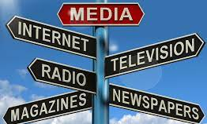
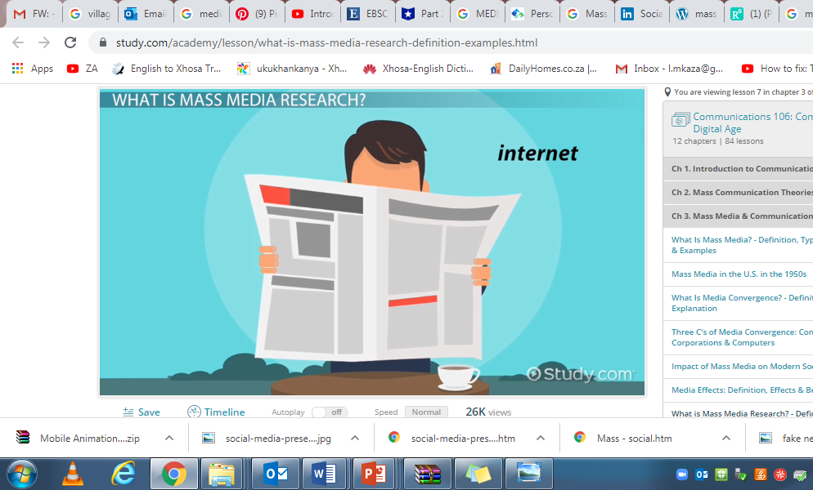
Mass Media
The media is a vehicle for a message.
Mass media are the channels of delivering one-to-many communication.
It is the means of transmitting messages to large audiences.
The channels used to deliver these messages could be mechanical or electronic.

Slide 4
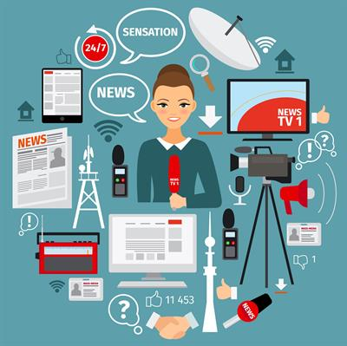
Mass Media continued…
Mass media broadcast messages to a large group of people who generally are not in direct contact with the source of the messages.
Mass media include television, newspapers, magazines, radios, books, and so forth.

Slide 5
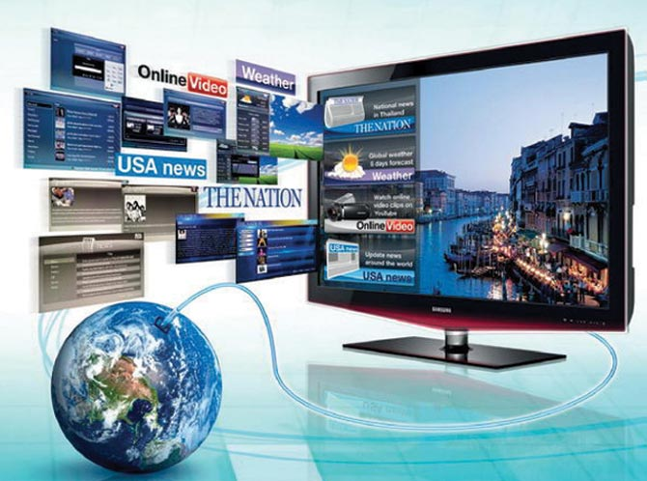
Examples of Mass Media products
SERIES
MOVIES
ADVERTISEMENTS
NEWSPAPERS
WEB NEWS SOURCES
EACH OF THESE MEDIA REACH A MASS AUDIENCE.

Slide 6
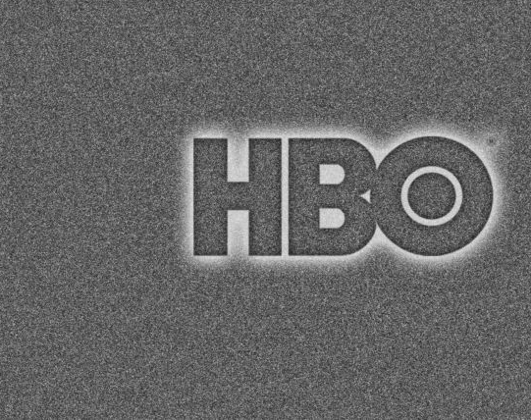
Popular American series that reached millions of viewers:
In America:
Game of Thrones - 19.3 million
Friends - 52.5 million
The Walking Dead - 4 million
West World -1.57 million
Insecure – 1.1 million

Slide 7

Popular Series in South Africa
Queen Sono
Blood and Water
Uzalo
Isidingo
The Queen
Muvhango
7de Laan

Slide 8

Netflix and Trend
Series can now be streamed through streaming services like Netflix and Showmax.
Popularity of series depends on what is trending on these platforms.

Slide 9
Best South African Movies of all time
South African movies usually depict the times in which they are produced.
Most post-apartheid movies are about nation building and interracial relationships.
Others, like Tsotsi, depict the harsh reality of South Africa.
Examples:
Tsotsi 2005
District 9- 2009
Invictus - 2009
Sarafina - 1992

Slide 10

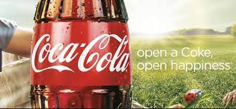
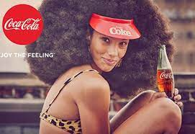

Advertisements
Coco-Cola - Enjoy the feeling!
- Open a Coke, open happiness.
Sta Soft – Soft as a mother’s love.
McDonald’s -I’m lovin’ it!

Slide 11
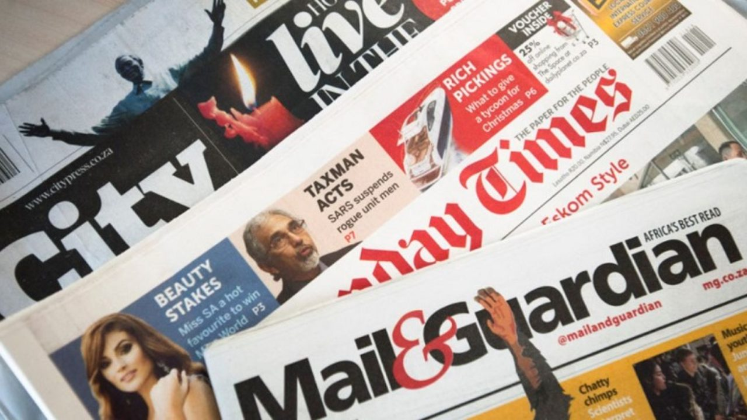
Newspapers
The Guardian
The Times
Cape Times
Beeld
Sunday Times
City Press
The Citizen
I'solezwe lesiXhosa

Slide 12
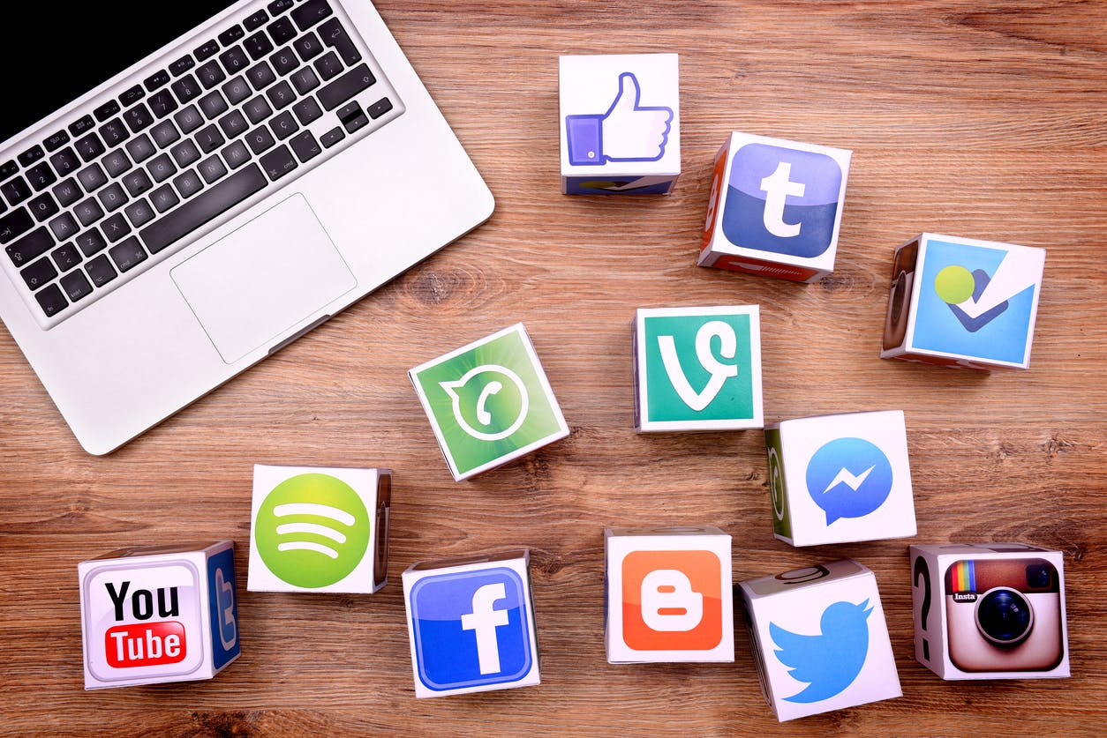
Social Media
Social media are means of connecting and interacting actively.
It is a technology produced social space (Nunes, 2006).
Combine the intimacy of the telephone with the reach of broadcast media and you have social media, the collection of tools used to connect people to one another (Fine, 2006).

Slide 13
Social Media- more definitions
They are online technologies and practices that people use to share opinions, insights, experiences, and perspectives with each other.
- www.tvb.org
“Social media are works of user-created video, audio, text or multimedia that are published and shared in a social environment, such as a blog, wiki or video hosting site.” - Capilanou University
An umbrella term that defines the various activities that integrate technology, social interaction, and the construction of words and pictures.”
-Anvil media

Slide 14
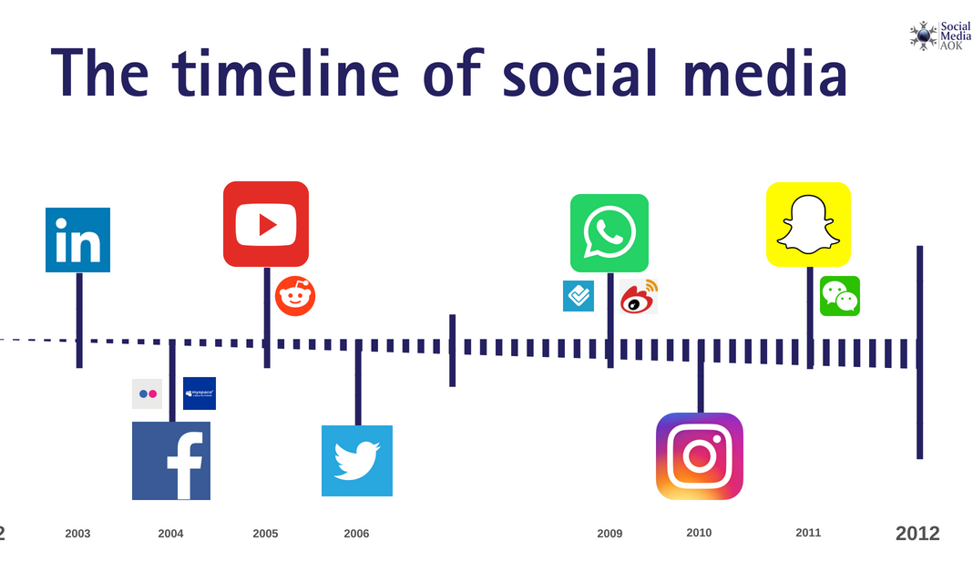
The history of social media
Six Degrees 1997-2001
Friendster 2002 -2015
LinkedIn 2002
My Space 2003
Facebook 2004
YouTube 2005
Twitter 2006
WhatsApp 2009
Instagram 2010
Tik Tok 2016

Slide 15
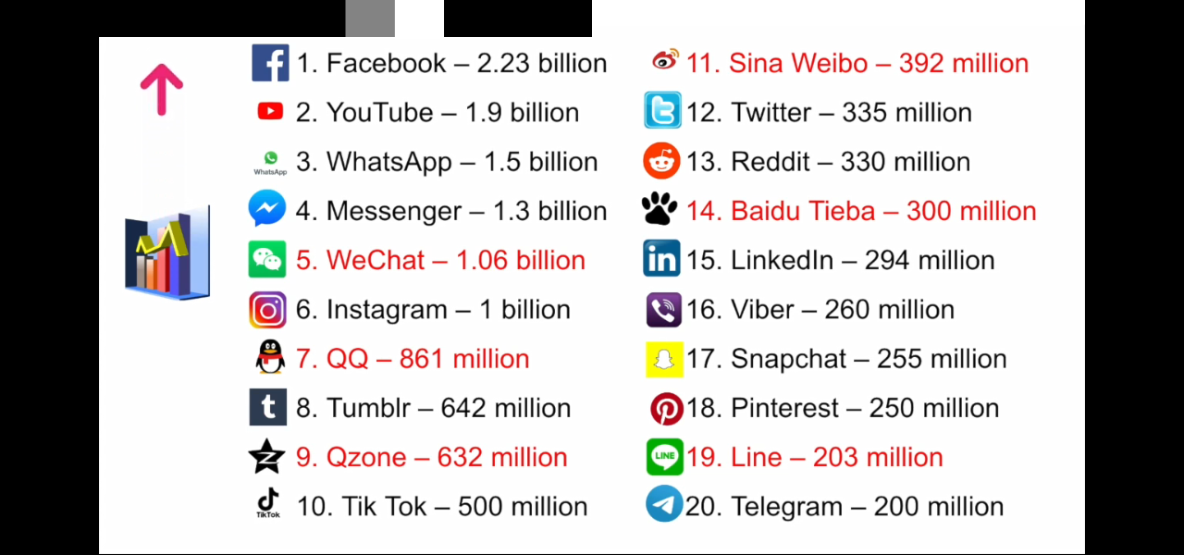
Social media user stats per month:

Slide 16
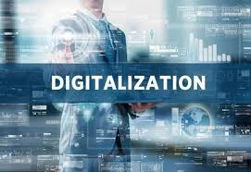
Difference between mass media and social media

Slide 17

Three key implications of digitalization:
1. Ease of manipulation
2. Convergence
3. Nearly instant speed

Slide 18
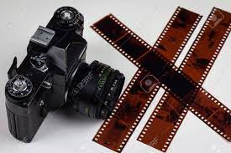
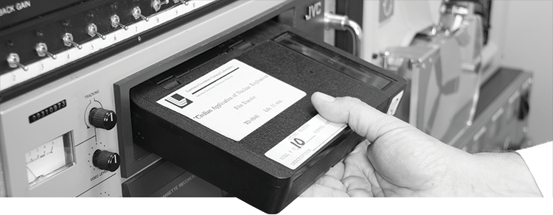
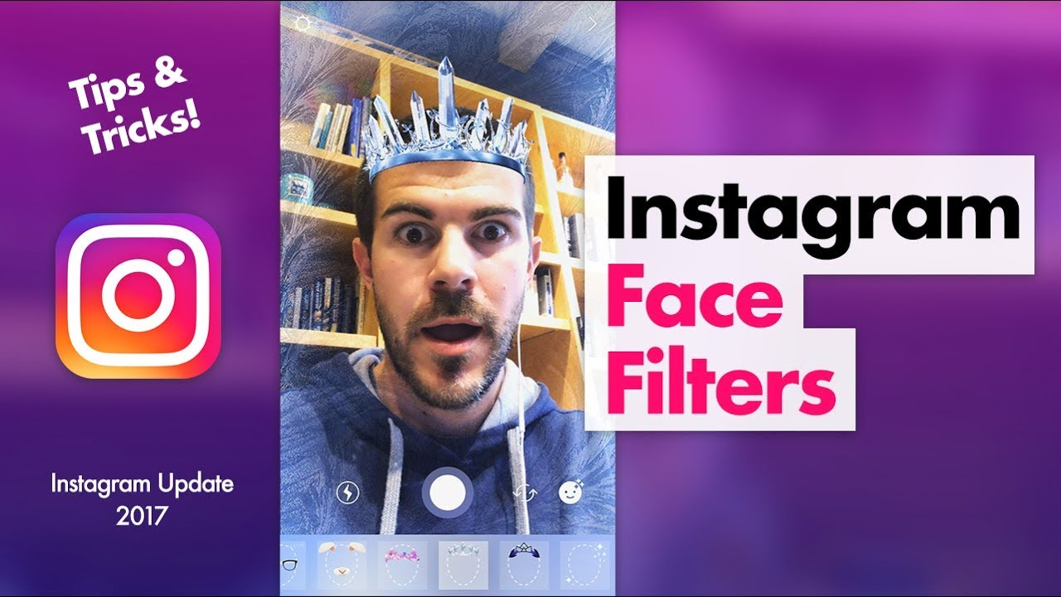
1. Ease of manipulation
Manipulation is not new; it was possible with analogue film and video and film photography.
For instance, a photo could be retouched and video could be edited. However, manipulating analogue media took a high level of skill that few people had.
In contrast, most people who have grown up using digital media know how to manipulate them—for instance, using Photoshop’s clone stamping or using Snap Chat filters that allow a person to alter a photo.
The line that divided production and consumption of media in the analogue era is blurred, if not erased in the digital era.

Slide 19
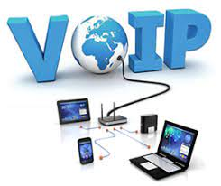

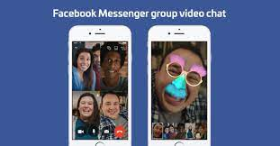
2. Convergence
Digital media also cultivate convergence. Just a few years ago, it was very difficult and expensive to have a Voice-Over Internet phone call.
Today, people across the world routinely have Voice-Over Internet phone conversations with family members.
This is possible because the technology for transmitting sound and the technology for transmitting visual images are both digital and, thus, they can be managed on a single network.
Various social media platforms such as WhatsApp and Facebook allow video calling.

Slide 20
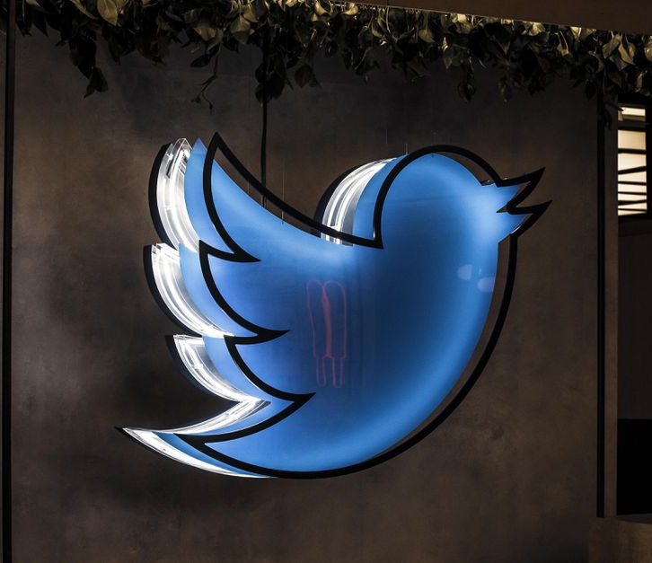
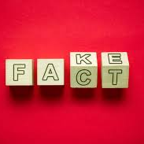

3. Nearly instant speed
The third feature of digital media is nearly instant speed.
The speed of information dissemination jeopardizes accuracy.
“In a world of instant access where everyone can be published or viewed, the time pressure and the volume increase make careful vetting that much harder” (Digital media scholar, Rayford Steele, 2009).

Slide 21
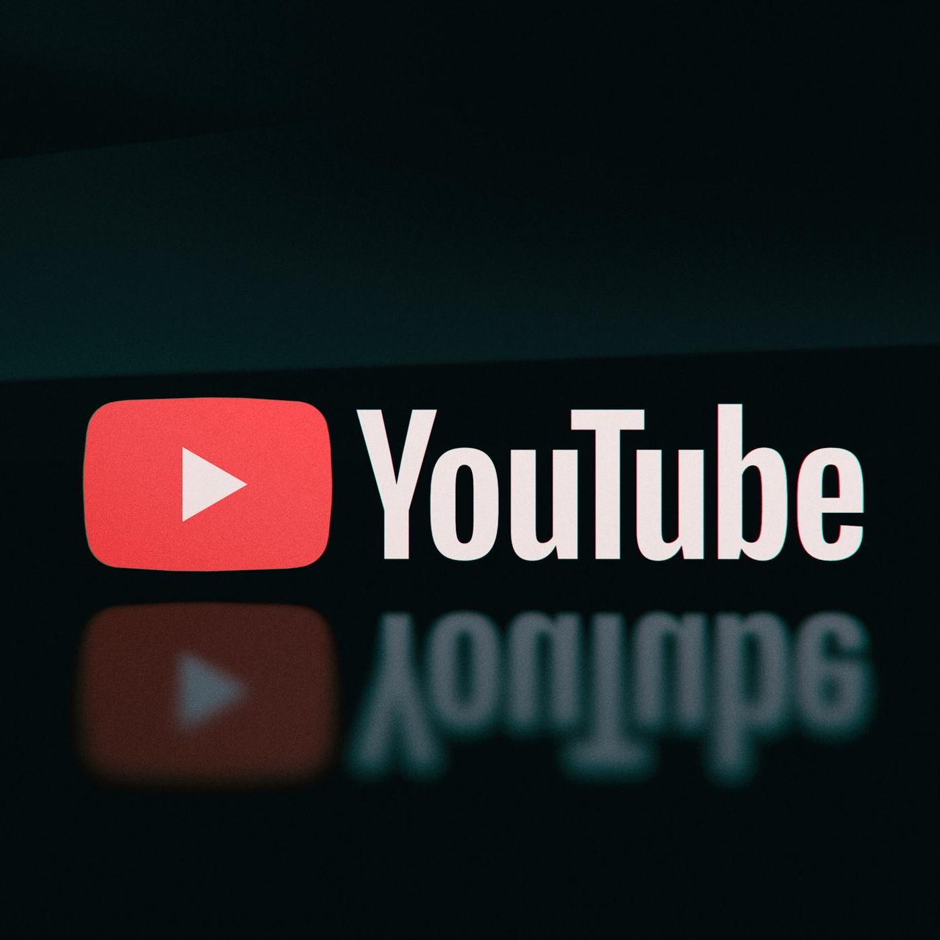
In-between media?
But the lines between social and mass media are not really clear cut.
For instance, if you send a video to a friend who then posts it on YouTube, have you engaged in personal communication or mass communication or both?
Stanley Baran and Dennis Davis (2003) believe it is more appropriate to think of media as a continuum that ranges from clearly interpersonal, or social, to clearly mass, with a lot of in-between media between those two extreme ends.

